Slide 1



Anderson vs Anderson
Filmography vs Filmography

Slide 2


Introduction
Motivation:
I have a love of movies and am particularly a fan of Paul Thomas Anderson’s cinematic depth. I’m curious to compare his breadth of work with director Wes Anderson’s
Data Sources:
The Movie Database (TMDb) API
Internation Movie Database (IMDb) library Cinemagoer
Rotten Tomatoes web scraping

Slide 3
Paul Thomas Anderson
Releasing features since 1996
First feature was the film Hard Eight staring Philip Baker Hall, John C. Reily, and Gweneth Paltrow
Has released 9 features in total, with his tenth film, One Battle After Another, being released later this year
First notable success was Boogie Nights, his second feature released in 1997
His most successful project was There Will Be Blood staring Daniel Day-Lewis, a frequent collaborator, in 2007

Slide 4

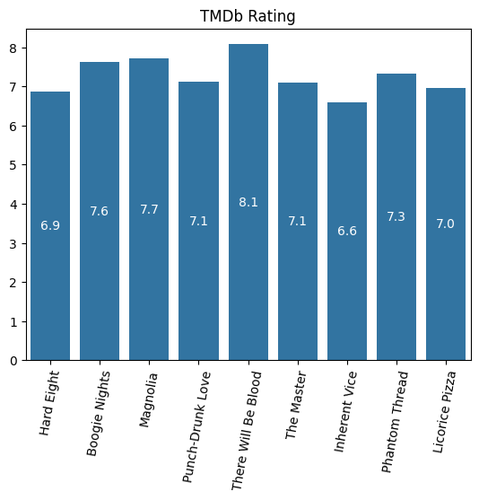

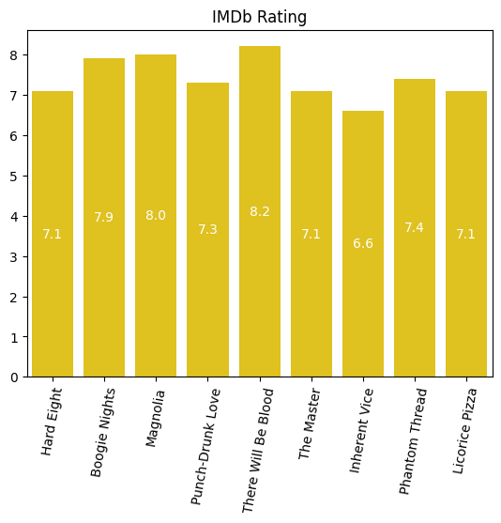
Paul Thomas Anderson
7.26
7.41

Slide 5
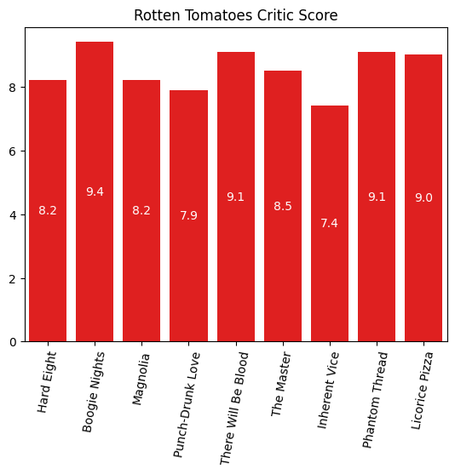

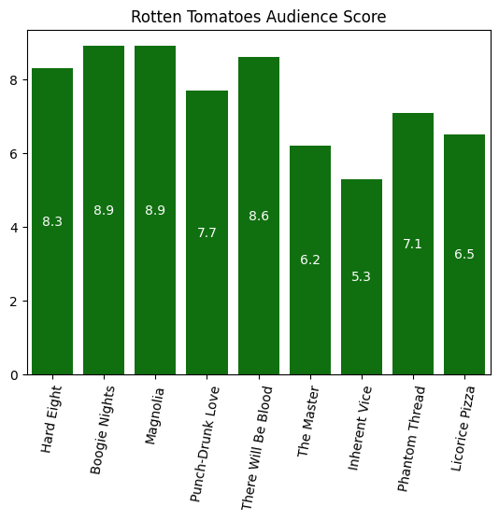
Paul Thomas Anderson
8.53
7.50

Slide 6
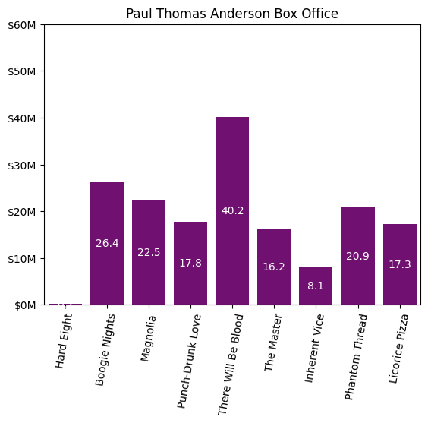
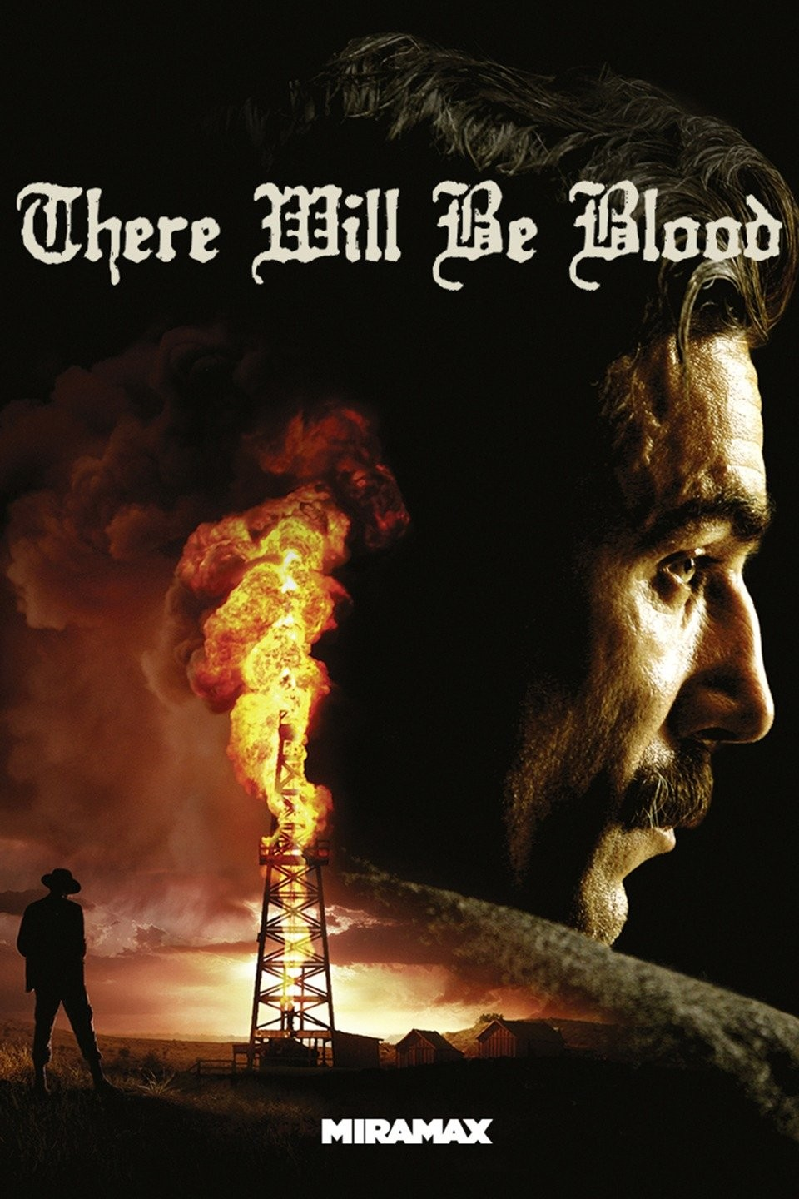

Paul Thomas Anderson
216K
170M
18.85M
40.2M

Slide 7
Wes Anderson
Began releasing feature films in 1996
First film was Bottle Rocket staring Luke and Owen Wilson
His first notable success was the 2001 film, The Royal Tenenbaums
His most successful film is The Grand Budapest Hotel which released in 2014

Slide 8
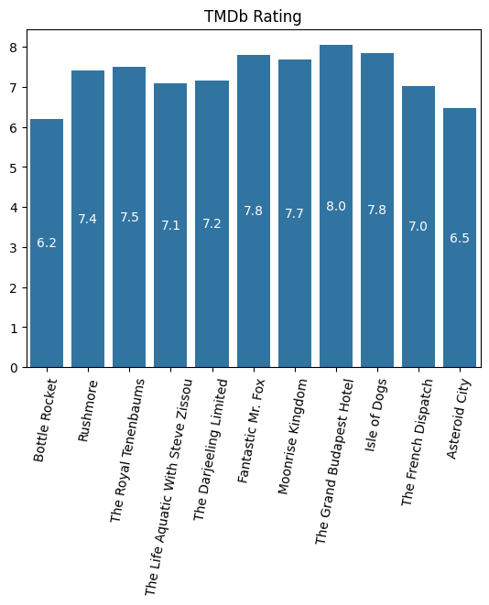
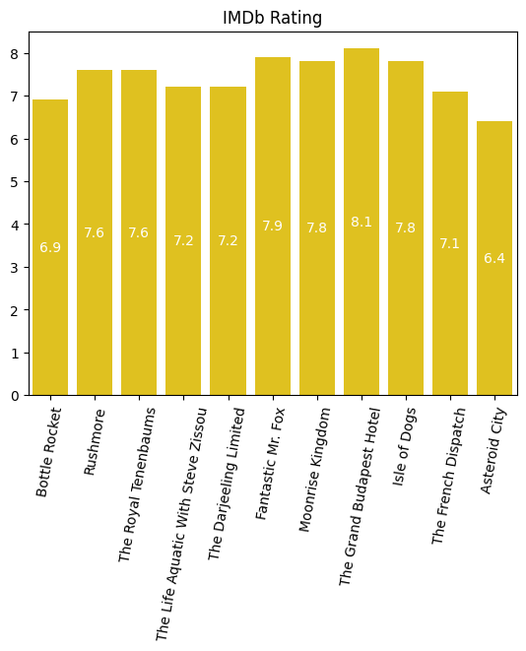
Wes Anderson
7.29
7.42

Slide 9
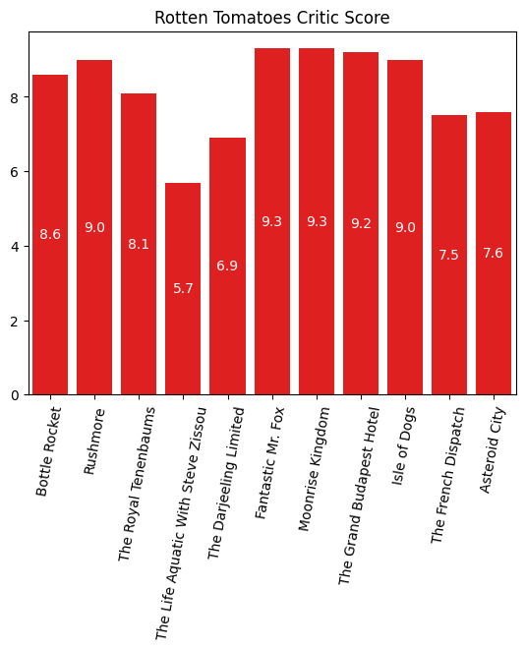
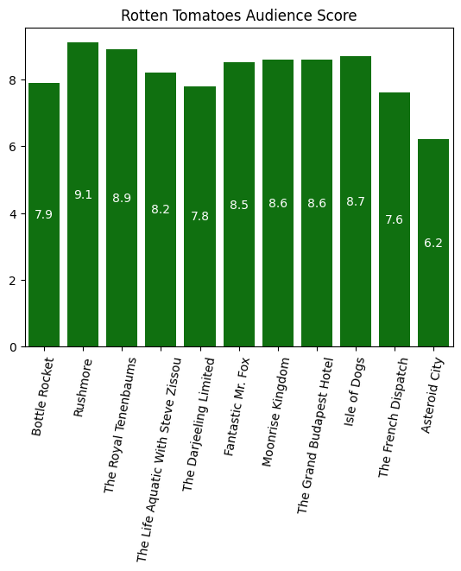
Wes Anderson
8.20
8.19

Slide 10
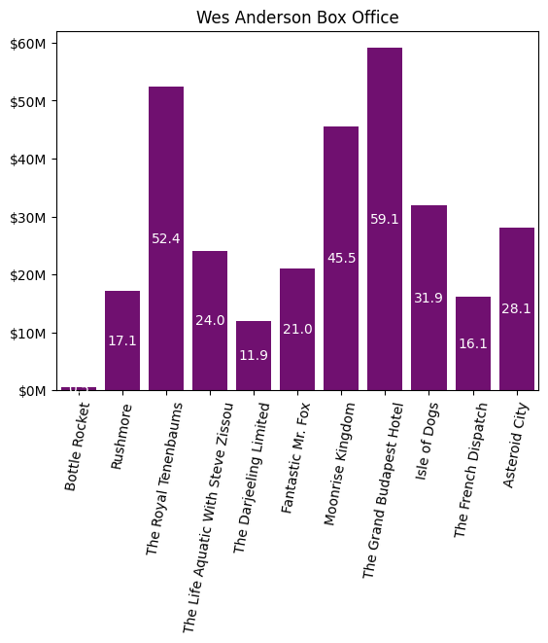


Wes Anderson
308M
488.6K
27.96M
59M
Notes:
Mention I am only focusing on the first 5 actors in the credits of each of his films in this data set.

Slide 11
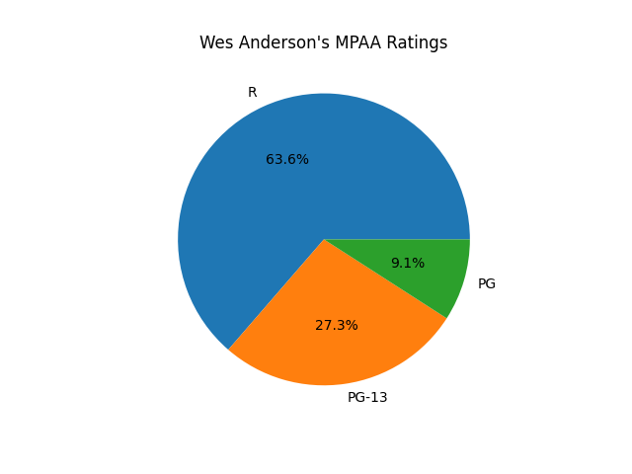
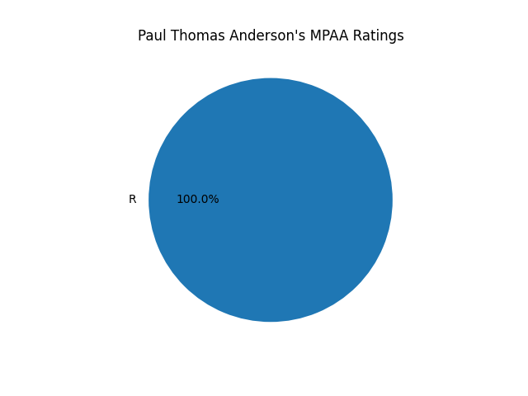
Anderson vs Anderson
Amount of Films
Nine versus Eleven

Slide 12
Anderson vs Anderson
Paul Thomas Anderson
Wes Anderson
7.26
7.29

Slide 13
Anderson vs Anderson
Paul Thomas Anderson
Wes Anderson
7.41
7.42

Slide 14
Anderson vs Anderson
Paul Thomas Anderson
Wes Anderson
8.53
8.20

Slide 15
Anderson vs Anderson
Paul Thomas Anderson
Wes Anderson
7.50
8.19

Slide 16
Anderson vs Anderson
Paul Thomas Anderson
Wes Anderson
170M
308M
(255M without animated)
18.85M
27.96M

Slide 17






Anderson vs Anderson

